Slide 1
Research of Approach Strategy for Fast Drone Autonomous Landing
By
Julien Mellet
Under the Supervision of Professor
Wang Jingyu
Master of Navigation, Guidance and Control
Xi’an P. R. China
June 2020
1

Slide 2
Summary of the presentation
Introduction
I. Drone Perception
II. Guidance and Control
III. Mechanical Landing Gears
Conclusion
1

Slide 3
Summary of the presentation
I. Drone Perception
Standard Fiducial Marker
Deep Learning Localization
Comparison Study
II. Guidance and Control
III. Mechanical Landing Gears
1

Slide 4
Summary of the presentation
I. Drone Perception
II. Guidance and Control
Software In The Loop Simulation
Drone Guidance
Landing Simulation
III. Mechanical Landing Gears
1

Slide 5
Summary of the presentation
I. Drone Perception
II. Guidance and Control
III. Mechanical Landing Gears
Absorber Gear Kinematic
Landing Gear Design
Shock Absorption Experiment
1

Slide 6
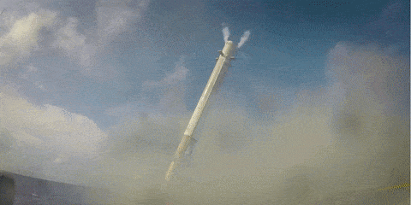
I. Drone Perception
II. Guidance and Control
III. Mechanical Landing Gears
Introduction
Why use reusable rockets ?
Space industry
Reduce cost
Improve reliability
1
Notes:
More and more satellite are sending to space which is a billion dollars market, and there are more and more actors in this fiels
Satellite constellation for global internet --> OneWeb and StarLink
The landing stage is always challenging as many crashes continue to happen
<number>

Slide 7
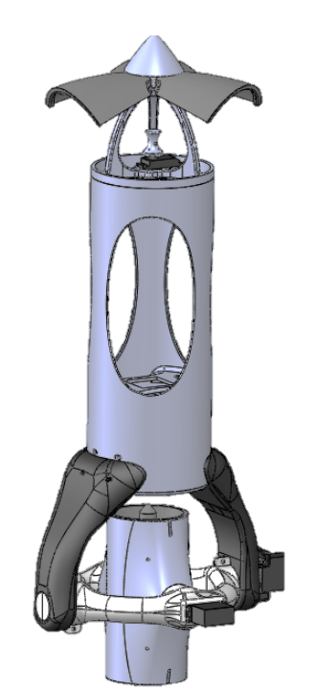
I. Drone Perception
II. Guidance and Control
III. Mechanical Landing Gears
Introduction
The e-rocket
Electric thrust vectored rocket
Easily reusable
No explosion
Drone component
1

Slide 8
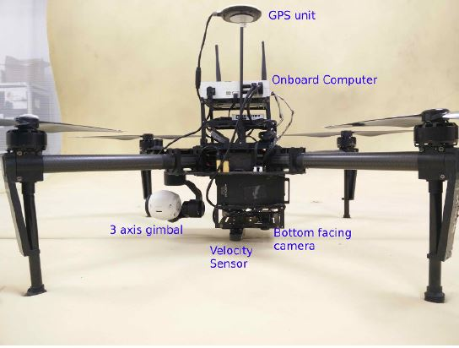
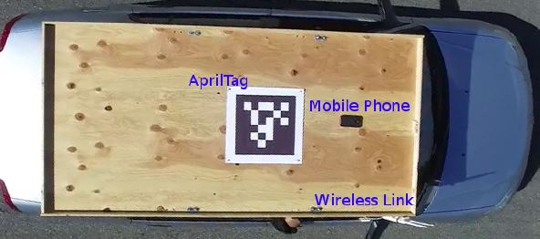
I. Drone Perception
II. Guidance and Control
III. Mechanical Landing Gears
Introduction
Related works
A. Borowczyk, et al. Autonomous Landing of a Multirotor Micro Air Vehicle on a High Velocity Ground Vehicle (2016)
1
Notes:
Entire drone autonomous landing project with standard approach
Using first GPS then Fiducial marker
<number>

Slide 9
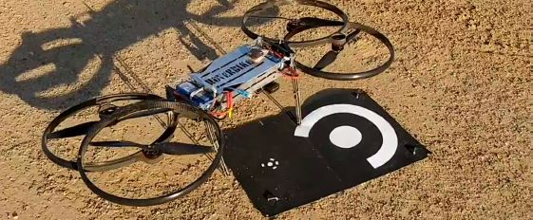
I. Drone Perception
II. Guidance and Control
III. Mechanical Landing Gears
Introduction
Related works
S. Recker, et al. Autonomous Precision Landing for the Joint Tactical Aerial Resupply Vehicle (2018)
1
Notes:
single-shot object detection network, called DetectNet
the network is a fully convolutional network based upon GoogLeNet
First detection, then localisation
<number>

Slide 10
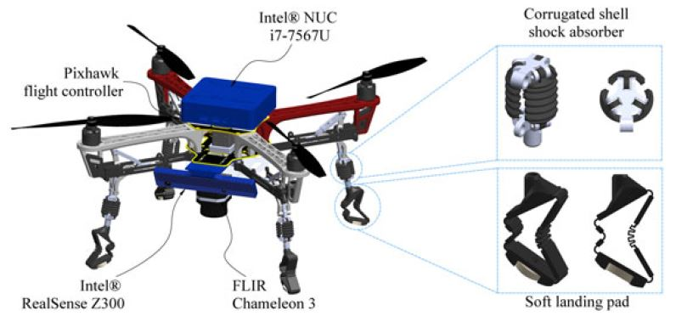
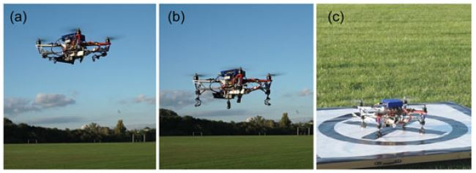
I. Drone Perception
II. Guidance and Control
III. Mechanical Landing Gears
Introduction
Related works
K. Zhang, et al. Bioinspired design of a landing system with soft shock absorbers for autonomous aerial robots (2018)
1
Notes:
Soft landing legs
Problems : Dead weight ; no dissipation mechanism
<number>

Slide 11
I. Drone Perception
II. Guidance and Control
III. Mechanical Landing Gears
Introduction
Basic Theory
Convolutional Neural Network (CNN): a network having one or several convolution layers
Robot Operating System (ROS): a robotic standard of communication that allows an entity to publish data on a topic, and another entity to subscribe to this topic
Flight Controller (FC): a chip board for drones that embeds several sensors to allow it to fly
k and c are respectively elastic and frictional coefficients of movement equations
1
Notes:
Soft landing legs
Problems : Dead weight ; no dissipation mechanism
<number>

Slide 12
I. Drone Perception
II. Guidance and Control
III. Mechanical Landing Gears
1.1. Standard Fiducial Marker
The variety of shapes
X-shaped marker
Circles marker
Square-based fiducial marker
Fractal marker
Complex shape
1
Notes:
Drone perception makes the drone aware of the environment, and it’s the richest way to acurately localize the target landing area
<number>

Slide 13
I. Drone Perception
II. Guidance and Control
III. Mechanical Landing Gears
1.1. Standard Fiducial Marker
Square-based fiducial marker
Marker Detection
1

Slide 14
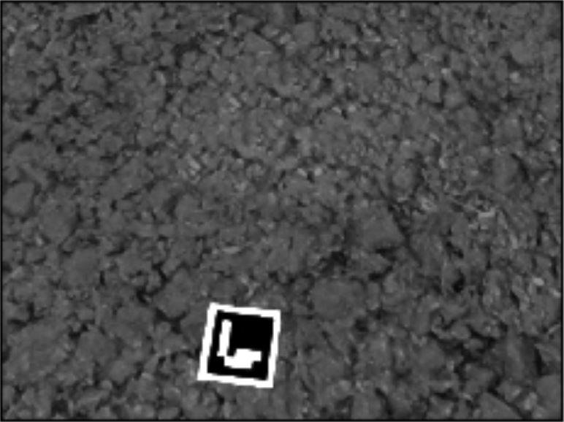
I. Drone Perception
II. Guidance and Control
III. Mechanical Landing Gears
1.1. Standard Fiducial Marker
Image capture
1.1.1.
Marker Detection
Gray-scale image
1

Slide 15
I. Drone Perception
II. Guidance and Control
III. Mechanical Landing Gears
1.1. Standard Fiducial Marker
Image capture
1.1.1.
Marker Detection
Gray-scale image
Adaptive threshold
Square shape identification
1

Slide 16
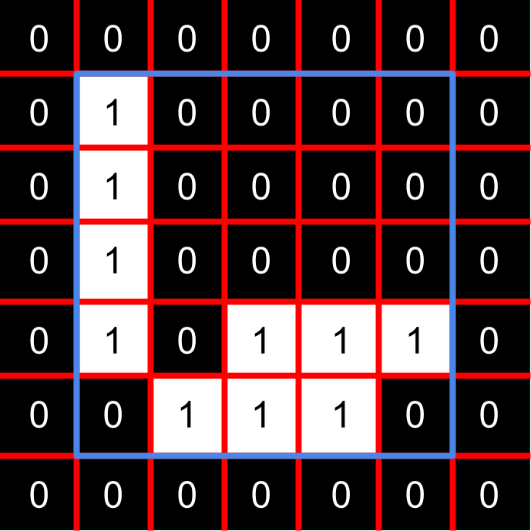
I. Drone Perception
II. Guidance and Control
III. Mechanical Landing Gears
1.1. Standard Fiducial Marker
Gray-scale image
1.1.1.
Marker Detection
Adaptive threshold
Square shape identification
Fiducial decoding
1

Slide 17
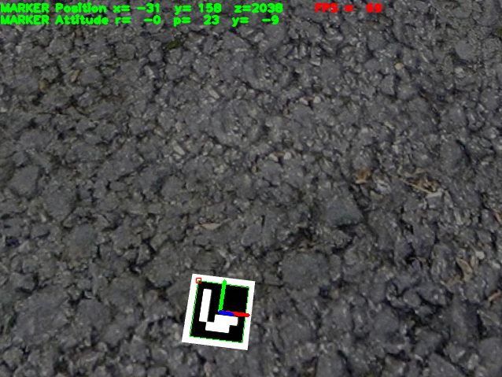
I. Drone Perception
II. Guidance and Control
III. Mechanical Landing Gears
1.1. Standard Fiducial Marker
1.1.2.
Adaptive threshold
Pose Estimation
Square shape identification
Fiducial decoding
Homography projection
1

Slide 18
I. Drone Perception
II. Guidance and Control
III. Mechanical Landing Gears
1.1. Standard Fiducial Marker
1.1.2.
Square shape identification
Pose Estimation
Fiducial decoding
Homography projection
Marker position
1

Slide 19
I. Drone Perception
II. Guidance and Control
III. Mechanical Landing Gears
1.1. Standard Fiducial Marker
1.1.2.
Pose Estimation
Image Capture
Gray-scale image
Adaptive threshold
Fiducial marker localization algorithm
Square shape identification
Fiducial decoding
Homography projection
Marker position
1

Slide 20
I. Drone Perception
II. Guidance and Control
III. Mechanical Landing Gears
1.2. Deep Learning Localization
1.2.1.
Dataset Generation
The landing pad shape:
Contrasted colors
Using black and white to enhance the distinction of the different elements composing the drawing
1

Slide 21
I. Drone Perception
II. Guidance and Control
III. Mechanical Landing Gears
1.2. Deep Learning Localization
1.2.1.
Dataset Generation
The landing pad shape:
Contrasted colors
Three points “L” shape
Minimum number to localize a 3D plan in space
1

Slide 22
I. Drone Perception
II. Guidance and Control
III. Mechanical Landing Gears
1.2. Deep Learning Localization
1.2.1.
Dataset Generation
The landing pad shape:
Contrasted colors
Three points “L” shape
Minimum number to localize a 3D plan in space
1

Slide 23
I. Drone Perception
II. Guidance and Control
III. Mechanical Landing Gears
1.2. Deep Learning Localization
1.2.1.
Dataset Generation
The landing pad shape:
Contrasted colors
Three points “L” shape
Asymmetric “L” shape
The “L” has two ends with distinct shapes
1

Slide 24
I. Drone Perception
II. Guidance and Control
III. Mechanical Landing Gears
1.2. Deep Learning Localization
1.2.1.
Dataset Generation
The landing pad shape:
Contrasted colors
Three points “L” shape
Asymmetric “L” shape
Redundancy
The “L” is present twice on the drawing to ensure perception in the event of partial visibility
1

Slide 25
I. Drone Perception
II. Guidance and Control
III. Mechanical Landing Gears
1.2. Deep Learning Localization
1.2.1.
Dataset Generation
The landing pad shape:
Contrasted colors
Three points “L” shape
Asymmetric “L” shape
Redundancy
Target center
Allows to estimate the middle of the square
<number>

Slide 26
I. Drone Perception
II. Guidance and Control
III. Mechanical Landing Gears
1.2. Deep Learning Localization
1.2.1.
Dataset Generation
The landing pad shape:
Contrasted colors
Three points “L” shape
Asymmetric “L” shape
Redundancy
Target center
<number>

Slide 27
I. Drone Perception
II. Guidance and Control
III. Mechanical Landing Gears
1.2. Deep Learning Localization
1.2.1.
Dataset Generation
Principle of the dataset:
Photo realistic virtual images
Using Blender 3D modeling software the landing pad is presented with texture.
<number>

Slide 28
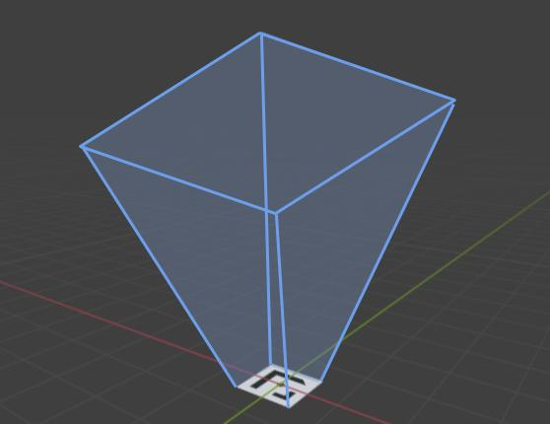
I. Drone Perception
II. Guidance and Control
III. Mechanical Landing Gears
1.2. Deep Learning Localization
1.2.1.
Dataset Generation
Principle of the dataset:
Photo realistic virtual images
Camera view area
Camera area boundaries depend on the camera field of view
<number>

Slide 29
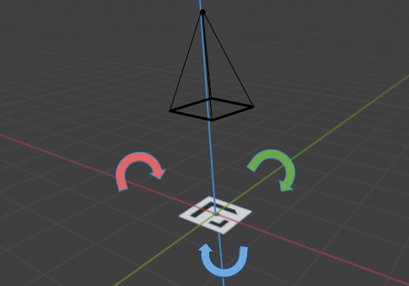
I. Drone Perception
II. Guidance and Control
III. Mechanical Landing Gears
1.2. Deep Learning Localization
1.2.1.
Dataset Generation
Principle of the dataset:
Photo realistic virtual images
Camera view area
Extreme pad rotations
Extreme rotations of the landing pad are proposed accordingly to maximum visible angles on all axis
<number>

Slide 30
I. Drone Perception
II. Guidance and Control
III. Mechanical Landing Gears
1.2. Deep Learning Localization
1.2.1.
Dataset Generation
Dataset samples:
Principle of the dataset:
Photo realistic virtual images
Camera view area
Extreme pad rotations
<number>

Slide 31
I. Drone Perception
II. Guidance and Control
III. Mechanical Landing Gears
1.2. Deep Learning Localization
1.2.2.
Neural Network
Image Capture
Gray-scale image
Standard marker pose estimation algorithm
Adaptive threshold
Square shape identification
Fiducial decoding
Homography projection
Marker position
<number>

Slide 32
I. Drone Perception
II. Guidance and Control
III. Mechanical Landing Gears
1.2. Deep Learning Localization
1.2.2.
Neural Network
Image Capture
Gray-scale image
Neural Network marker pose estimation algorithm
Adaptive threshold
Square shape identification
NN pose estimation
Fiducial decoding
Homography projection
Marker position
<number>
Notes:
Less steps for a faster pose estimation
<number>

Slide 33
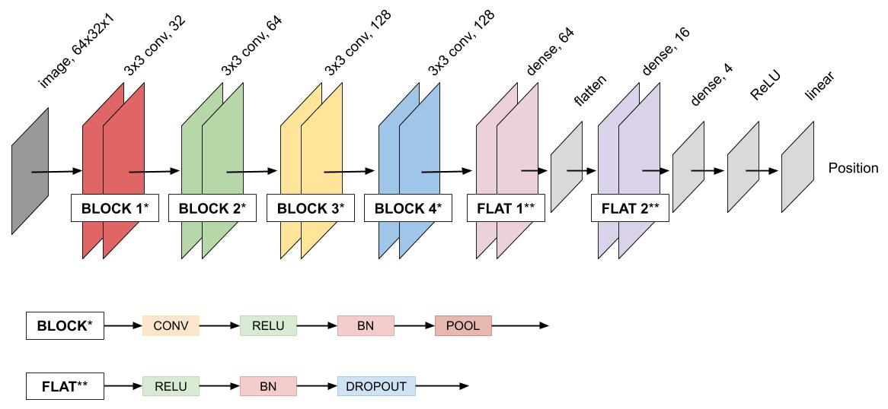
I. Drone Perception
II. Guidance and Control
III. Mechanical Landing Gears
1.2. Deep Learning Localization
1.2.2.
Neural Network
The proposed neural network architecture:
Image Capture
Gray-scale image
NN pose estimation
Marker position
<number>
Notes:
Split in two for x and y pose estimation
Regression layer at the end to estimate pose instead of classify
<number>

Slide 34
I. Drone Perception
II. Guidance and Control
III. Mechanical Landing Gears
1.2. Deep Learning Localization
1.2.2.
Neural Network
The training
Training dataset size: 1980 images
Test dataset size: 100 images
Number of epochs: 140
<number>

Slide 35
I. Drone Perception
II. Guidance and Control
III. Mechanical Landing Gears
1.2. Deep Learning Localization
1.2.2.
Neural Network
Predictions
Centered marker
Side marker
No marker
<number>

Slide 36
I. Drone Perception
II. Guidance and Control
III. Mechanical Landing Gears
1.2. Deep Learning Localization
1.2.2.
Neural Network
Predictions
Centered marker
Side marker
No marker
<number>
Notes:
The use of grad-CAM algorithm allows to see with part of the image has been stimulated in yellow
<number>

Slide 37
I. Drone Perception
II. Guidance and Control
III. Mechanical Landing Gears
1.3. Comparison Results
1.3.1.
Pose Measurements
Experiment hypothesis:
3 different landing pad
ArUco
Fractal
Neural Network
Same marker size
100 images for the NN and 200 images for ArUco and Fractal
Images are randomly distributed over the range previously presented, and generated with the dataset generator
<number>

Slide 38
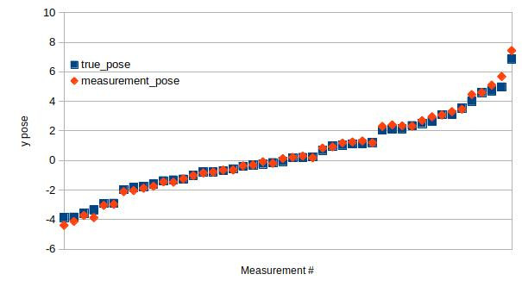
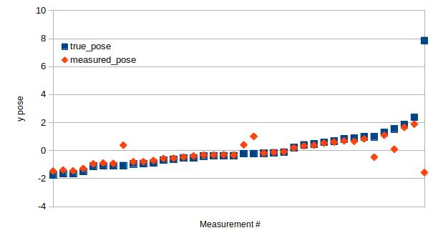
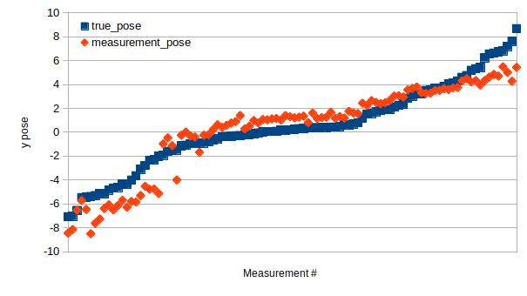
I. Drone Perception
II. Guidance and Control
III. Mechanical Landing Gears
1.3. Comparison Results
1.3.1.
Pose Measurements
ArUco
Fractal
Neural Network
<number>
Notes:
Here is the landing pad position in vertical and data are order increasingly from left to right
We can pay attention to the range of values of each algorithm
<number>

Slide 39
I. Drone Perception
II. Guidance and Control
III. Mechanical Landing Gears
1.3. Comparison Results
1.3.2.
Notable Observations
Algorithm | Range (m) | Images seen (%) | Accuracy (%)
 | 10.8 | 23 | 17.4
 | 4.2 | 19 | 49.1
 | 15.5 | 100 | 12.5
ArUco
Fractal
Neural Network
<number>

Slide 40
I. Drone Perception
II. Guidance and Control
III. Mechanical Landing Gears
2.1. Software In The Loop Simulation
2.1.1.
Simulator Overview
Gazebo
Realtime operation
Realistic Environment
PX4 Flight Controller
ROS Implementation
Active community
<number>
Notes:
robust physics engine, high-quality graphics, and convenient programmatic and graphical interfaces
ability to accurately and efficiently simulate populations of robots in complex indoor and outdoor environments
<number>

Slide 41
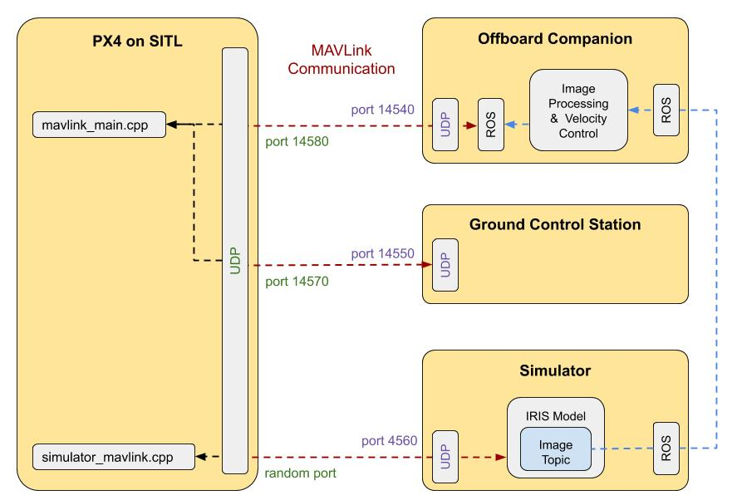
I. Drone Perception
II. Guidance and Control
III. Mechanical Landing Gears
2.1. Drone Simulator
2.1.2.
Simulator Implementation
<number>

Slide 42
I. Drone Perception
II. Guidance and Control
III. Mechanical Landing Gears
2.1. Drone Simulator
2.1.2.
Simulator Implementation
Simulated Flight Controller with real connection implementation
<number>

Slide 43
I. Drone Perception
II. Guidance and Control
III. Mechanical Landing Gears
2.1. Drone Simulator
2.1.2.
Simulator Implementation
Ground Control software that allows communication with the drone
<number>

Slide 44
I. Drone Perception
II. Guidance and Control
III. Mechanical Landing Gears
2.1. Drone Simulator
2.1.2.
Simulator Implementation
Gazebo simulator that simulate stimulations of the systems
<number>

Slide 45
I. Drone Perception
II. Guidance and Control
III. Mechanical Landing Gears
2.1. Drone Simulator
2.1.2.
Simulator Implementation
Image reception by ROS
Localization with visual processing
Send velocity control
<number>

Slide 46
I. Drone Perception
II. Guidance and Control
III. Mechanical Landing Gears
2.2. Drone Guidance
Autopilot architecture embedded with a multi-thread communication
<number>

Slide 47
I. Drone Perception
II. Guidance and Control
III. Mechanical Landing Gears
2.2. Drone Guidance
Filtering stages:
Raw data
Kalman Filter (KF)
Low pass filtering
<number>

Slide 48
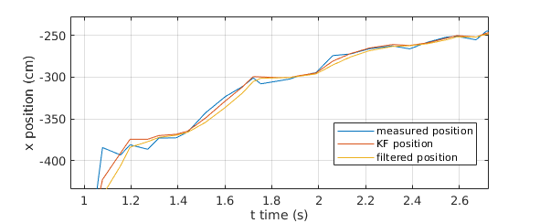
I. Drone Perception
II. Guidance and Control
III. Mechanical Landing Gears
2.2. Drone Guidance
Filtering stages:
Raw data
Kalman Filter (KF)
Low pass filtering
<number>
Notes:
KF has inertia
At the end we obtain the smooth yellow curve
<number>

Slide 49
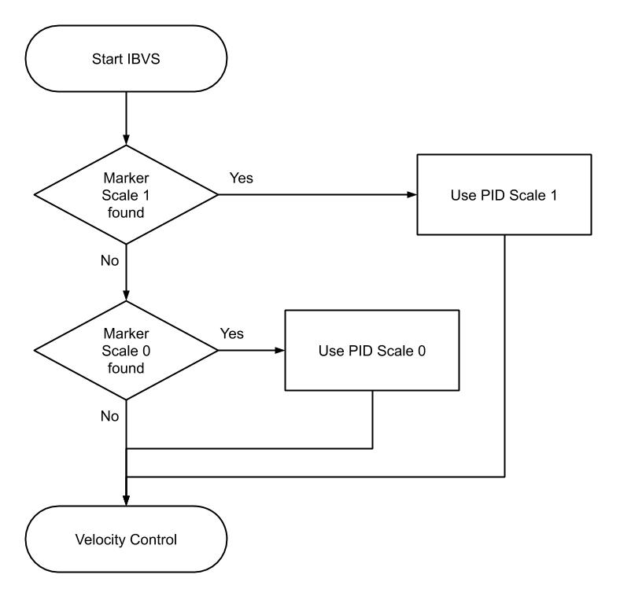
I. Drone Perception
II. Guidance and Control
III. Mechanical Landing Gears
2.2. Drone Guidance
2.2.2.
Multi-Scale Control
Cascade of two scaled PID depending on the height
Detection of smaller marker starts the following PID
Can be extended to n scales
<number>
Notes:
<number>

Slide 50
I. Drone Perception
II. Guidance and Control
III. Mechanical Landing Gears
2.3. Landing Simulation
2.3.1.
Video of a Landing
<number>
Notes:
<number>

Slide 51
I. Drone Perception
II. Guidance and Control
III. Mechanical Landing Gears
2.3. Landing Simulation
2.3.2.
Comparison results
Experiment hypothesis:
Random horizontal position
10 m altitude
0.8*0.8 m² marker
2 different algorithms
Standard PID for ArUco and NN detection
Multi-scale for Fractal marker
<number>
Notes:
<number>

Slide 52
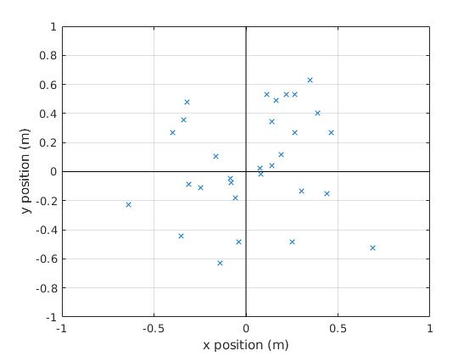
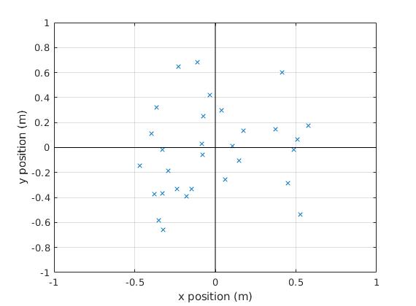
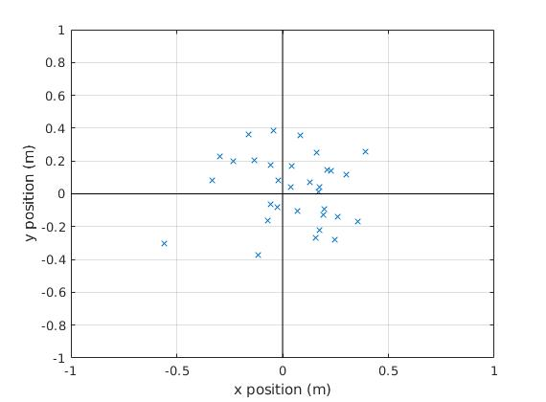
I. Drone Perception
II. Guidance and Control
III. Mechanical Landing Gears
2.3. Landing Simulation
2.3.2.
Comparison results
Landing positions
ArUco
Neural Network
Fractal
Standard PID
Standard PID
Multi-scale PID
<number>
Notes:
Interesting to see the dispersion
<number>

Slide 53
I. Drone Perception
II. Guidance and Control
III. Mechanical Landing Gears
2.3. Landing Simulation
2.3.2.
Comparison results
Summary table
Algorithm | Range (m) | Accuracy (%) | Rate (Hz)
 | 1.4 | 5.3 | 7.1
 | 0.9 | 3.8 | 4.3
 | 1.2 | 3.0 | 22.5
ArUco
Fractal
Neural Network
<number>
Notes:
Finally the NN gives the best results
<number>

Slide 54
I. Drone Perception
II. Guidance and Control
III. Mechanical Landing Gears
2.3. Landing Simulation
2.3.2.
Comparison results
Summary table
Algorithm | Range (m) | Accuracy (%) | Rate (Hz)
 | 1.4 | 5.3 | 7.1
 | 0.9 | 3.8 | 4.3
 | 1.2 | 3.0 | 22.5
ArUco
Fractal
Neural Network
<number>
Notes:
Finally the NN gives the best results
<number>

Slide 55
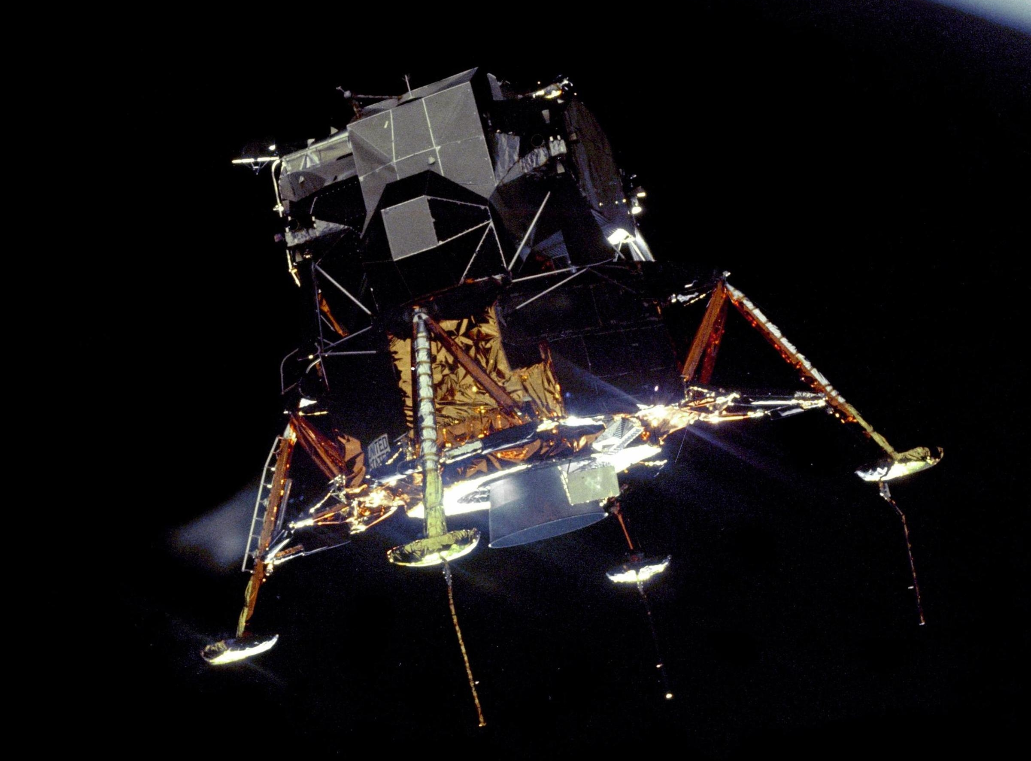
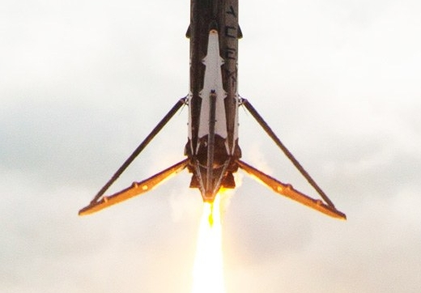
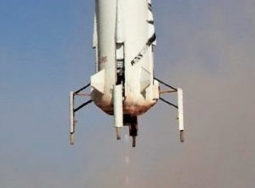
I. Drone Perception
II. Guidance and Control
III. Mechanical Landing Gears
3.1. Absorber Gear Kinematic
3.1.1.
Existing Systems
Apollo lunar lander
Blue Origin rocket
Space X rocket
<number>
Notes:
<number>

Slide 56
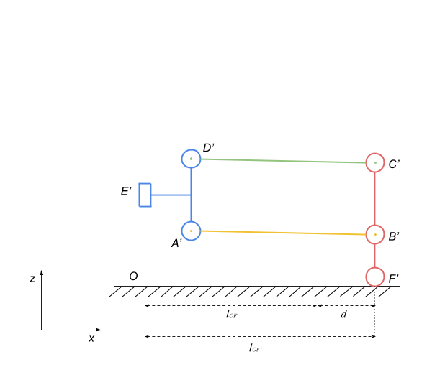
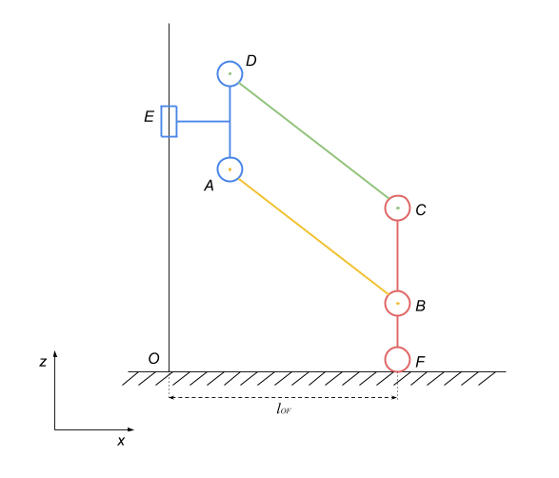
I. Drone Perception
II. Guidance and Control
III. Mechanical Landing Gears
3.1. Absorber Gear Kinematic
3.1.1.
Existing Systems
Displacement of the touching ground part that can cause damages
<number>
Notes:
Frictional effect on the ground, dangerous on surface
<number>

Slide 57
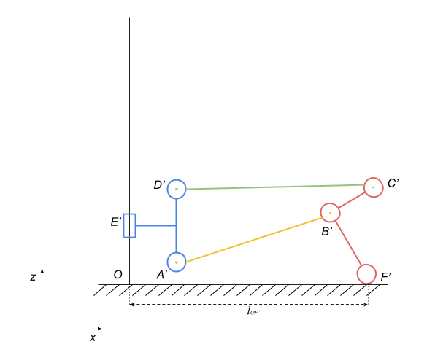
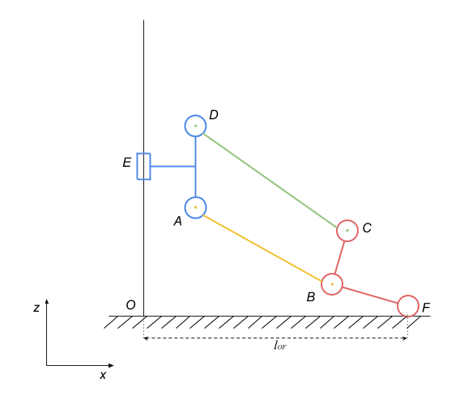
I. Drone Perception
II. Guidance and Control
III. Mechanical Landing Gears
3.1. Absorber Gear Kinematic
3.1.2.
Proposed Kinematic
Relative movement of the mechanism where the touching ground part does not silde
<number>
Notes:
<number>

Slide 58
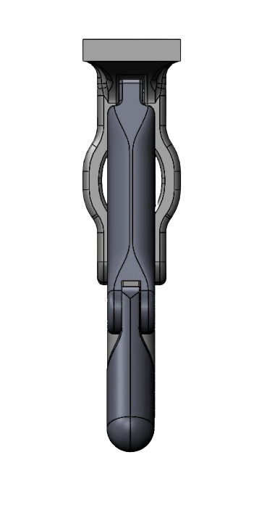
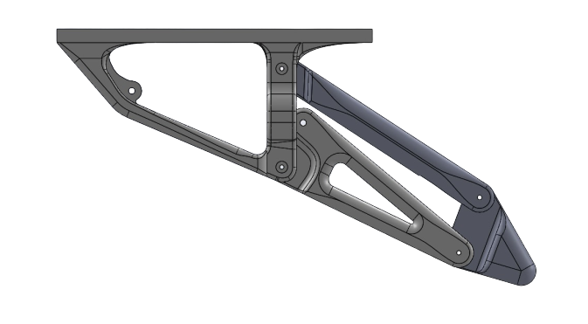
I. Drone Perception
II. Guidance and Control
III. Mechanical Landing Gears
3.2. Landing Gear Design
3.2.1.
Rigid Landing Gear
CAD assembly of the rigid landing gear mechanism
<number>
Notes:
<number>

Slide 59
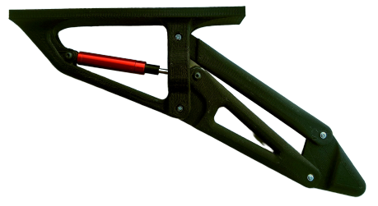
I. Drone Perception
II. Guidance and Control
III. Mechanical Landing Gears
3.2. Landing Gear Design
3.2.1.
Rigid Landing Gear
Real assembly of the rigid landing gear mechanism after 3D printing
<number>
Notes:
(show the 3D printed prototype)
<number>

Slide 60
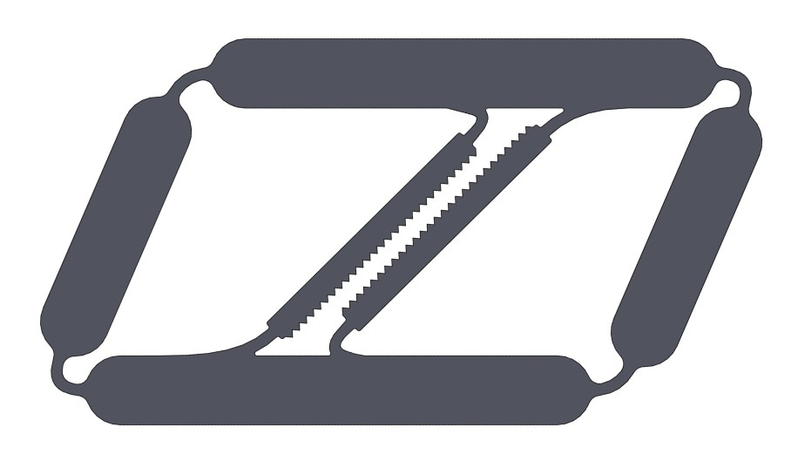
I. Drone Perception
II. Guidance and Control
III. Mechanical Landing Gears
3.2. Landing Gear Design
3.2.2.
Compliant Landing Gear
Frictional effect
Sliding frictional part test
Improved sliding frictional part
<number>
Notes:
The result showed little frictional effect,
Even with the improvement of the frictional effect
(show the 3D printed prototype)
<number>

Slide 61
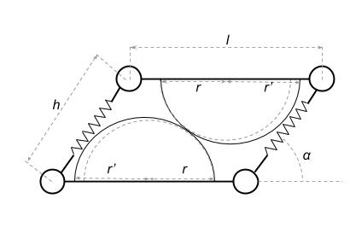
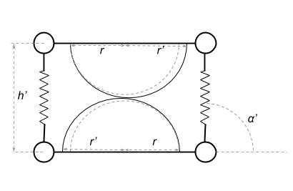
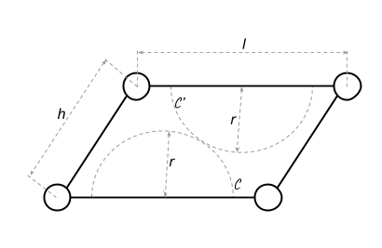
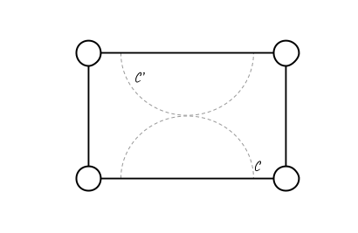
I. Drone Perception
II. Guidance and Control
III. Mechanical Landing Gears
3.2. Landing Gear Design
3.2.2.
Compliant Landing Gear
Frictional effect
<number>
Notes:
(show the 3D printed prototype)
<number>

Slide 62
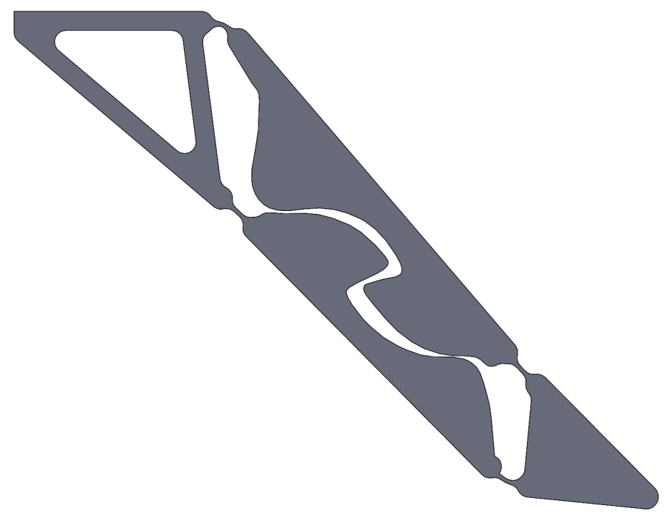
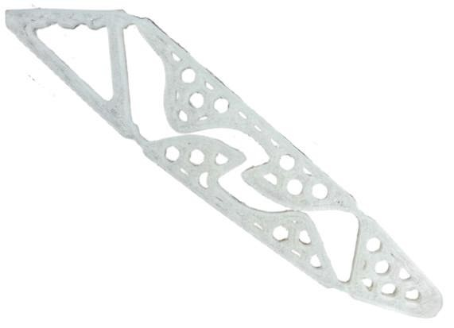
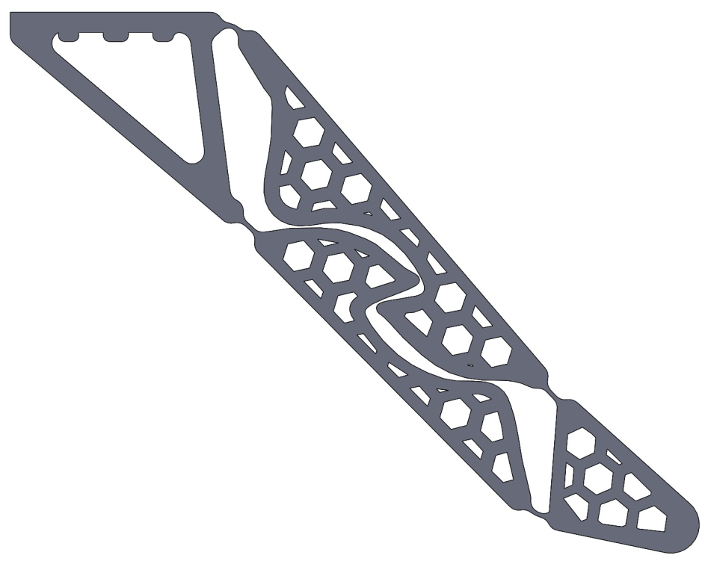
I. Drone Perception
II. Guidance and Control
III. Mechanical Landing Gears
3.2. Landing Gear Design
3.2.2.
Compliant Landing Gear
Compliant design
<number>
Notes:
(show the 3D printed prototype)
<number>

Slide 63
I. Drone Perception
II. Guidance and Control
III. Mechanical Landing Gears
3.3. Shock Absorption Experiment
3.3.1.
Experiment Procedure
Landing gears compared:
Little commercial
Big commercial
Rigid landing gear with different coefficients k and c
Compliant landing gear
<number>
Notes:
<number>

Slide 64
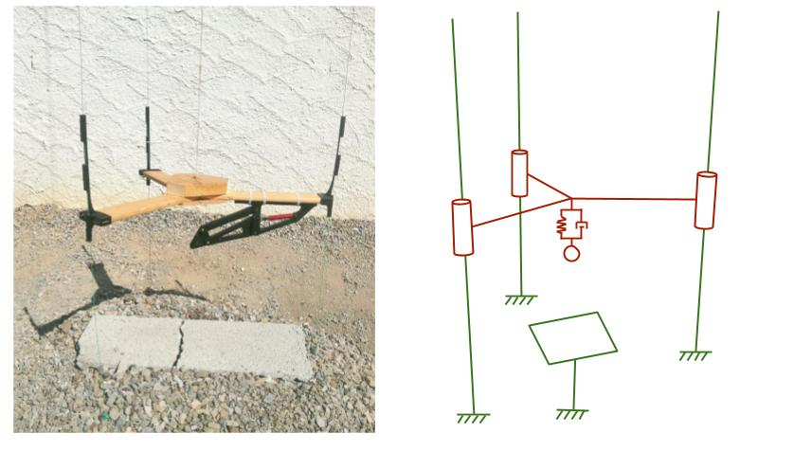
I. Drone Perception
II. Guidance and Control
III. Mechanical Landing Gears
3.3. Shock Absorption Experiment
3.3.1.
Experiment Procedure
Experimental benchmark
<number>
Notes:
<number>

Slide 65
I. Drone Perception
II. Guidance and Control
III. Mechanical Landing Gears
3.3. Shock Absorption Experiment
3.3.1.
Experiment Procedure
Video with rigid landing gear
<number>
Notes:
<number>

Slide 66
I. Drone Perception
II. Guidance and Control
III. Mechanical Landing Gears
3.3. Shock Absorption Experiment
3.3.1.
Experiment Procedure
Video with compliant landing gear
<number>
Notes:
<number>

Slide 67
I. Drone Perception
II. Guidance and Control
III. Mechanical Landing Gears
3.3. Shock Absorption Experiment
3.3.2.
Experiment Results
Commercial landing legs broke under a meter drop
Compliant landing gear had a better absorption effect for a given velocity drop
Rigid landing gears with high “c” coefficient finished with higher kinetic energy absorption
<number>
Notes:
<number>

Slide 68
I. Drone Perception
II. Guidance and Control
III. Mechanical Landing Gears
Conclusion
Summary
Drone Perception
Guidance and Control
Mechanical Landing Gears
<number>

Slide 69
I. Drone Perception
II. Guidance and Control
III. Mechanical Landing Gears
Conclusion
Summary
Drone Perception
A photorealistic dataset generator has been made, and a trained Convolutional Neural Network has reached a wider landing pad localization than standard marker localization
Guidance and Control
Mechanical Landing Gears
<number>
Notes:
<number>

Slide 70
I. Drone Perception
II. Guidance and Control
III. Mechanical Landing Gears
Conclusion
Summary
Drone Perception
Guidance and Control
A companion computer implementation has been proposed. It provides an optimal localization estimation for fast landing. The NN has a fast estimation rate, while the multiscale PID allows a more accurate landing
Mechanical Landing Gears
<number>

Slide 71
I. Drone Perception
II. Guidance and Control
III. Mechanical Landing Gears
Conclusion
Summary
Drone Perception
Guidance and Control
Mechanical Landing Gears
The landing velocity has been increased with a proposed landing gear. The kinematic allows a vertical movement, and the energy dissipation is better. A light weight was possible thanks to the use of a compliant mechanism
<number>

Slide 72
I. Drone Perception
II. Guidance and Control
III. Mechanical Landing Gears
Conclusion
Future Works
E-rocket implementation
Unreal Engine dataset generator
Real-world experimentations
<number>
Notes:
Real world experimentation because this has been stopped with the covid
<number>

Slide 73
I. Drone Perception
II. Guidance and Control
III. Mechanical Landing Gears
Bibliography
A. Borowczyk, A. Nguyen, D. Nguyen, et al. Autonomous Landing of a Multirotor Micro Air Vehicle on a High Velocity Ground Vehicle[J]. IFAC-PapersOnLine, 2016:2373-2380
S. Recker, C. Gribble, M. Butkiewicz. Autonomous Precision Landing for the Joint Tactical Aerial Resupply Vehicle[C]//IEEE Applied Imagery Pattern Recognition Workshop(AIPR). Washington, USA: IEEE, 2018:1-8.
K. Zhang, P. Chermprayong, D. Tzoumanikas, et al. Bioinspired design of a landing system with soft shock absorbers for autonomous aerial robots[J]. Journal of Field Robotics,2018, 36.
OpenCV, Detection of aruco markers[Z]. How it was published. accessed on 04.06.2020.2020
L. Meier, P. Tanskanen, F. Fraundorfer, et al. PIXHAWK: A system for autonomous flight using onboard computer vision[C]//IEEE International Conference on Robotics and Automation. Shanghai, China: IEEE, 2011:2992-2997
R. Selvaraju, M. Cogswell, A. Das, et al. Grad-CAM: Visual Explanations from DeepNetworks via Gradient-Based Localization[C]//IEEE International Conference on Computer Vision (ICCV). Venice, Italy: IEEE, 2017:618-626
<number>
Notes:
<number>

Slide 74
I. Drone Perception
II. Guidance and Control
III. Mechanical Landing Gears
Thank you
<number>
Notes:
<number>

